Slide 1
Exercises Module 5

Slide 2
Calculate the Hamming difference between two DNA strands.
Calculate the Hamming Distance between two DNA strands.
Your body is made up of cells that contain DNA. Those cells regularly wear out and need replacing, which they achieve by dividing into daughter cells. In fact, the average human body experiences about 10 quadrillion cell divisions in a lifetime!
When cells divide, their DNA replicates too. Sometimes during this process mistakes happen and single pieces of DNA get encoded with the incorrect information. If we compare two strands of DNA and count the differences between them we can see how many mistakes occurred. This is known as the "Hamming Distance".
We read DNA using the letters C,A,G and T. Two strands might look like this:
GAGCCTACTAACGGGAT
CATCGTAATGACGGCCT
They have 7 differences, and therefore the Hamming Distance is 7.

Slide 3
Luhn Formula
How to validate a Credit Card Number?
Most credit card number can be validated using the Luhn algorithm, which is more or a less a glorified Modulo 10 formula!
The Luhn Formula:
Drop the last digit from the number. The last digit is what we want to check against
Reverse the numbers
Multiply the digits in odd positions (1, 3, 5, etc.) by 2 and subtract 9 to all any result higher than 9
Add all the numbers together
The check digit (the last number of the card) is the amount that you would need to add to get a multiple of 10 (Modulo 10)

Slide 4
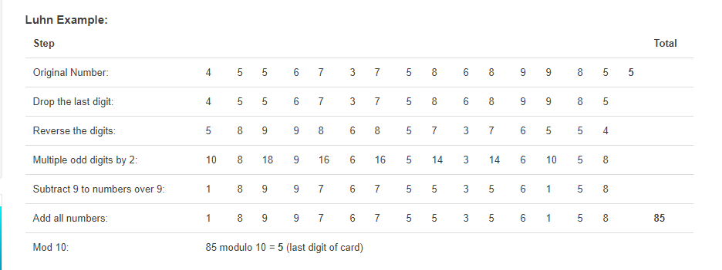
Luhn Example

